Slide 1

Understand GOLD SENTIMENT Using Sentiment Analysis
MINIPROJECT PRESENTATION
FROM DYLAN LOH
Feb-2022

Slide 2
Introduction
Traditionally Traders uses Charts, Economy Indicators and News to predict Gold Prices; all based on global events.
With the growth of Internet and Social Media and growing participation of Retail Traders, Gold Prices (and other financial prices) are experiencing higher fluctuation.
Traders cannot ignore the influence from Social Media.
Hence I hope this project will be useful to close the gap of additional tools that Traders will need.

Slide 3
Objectives
This project hope to use Social Media for Sentiment Analysis for Trading Gold.
The choice of Social Media, we have chosen Twitter and GoogleNews

Slide 4
Dataset
Twitter (1000 rows of tweets)
Google News (20 rows of news)
This is based on 2 days of live data.

Slide 5
The Process
Data Collection
Pre-Processing
Perform Sentiment Analysis
Graphic Visualisation

Slide 6
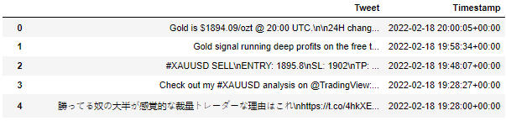
Data Collection from Twitter Tweets
We uses Twitter API to connect.
Hastag = #GOLD XAUUSD
We managed to obtain 1000 twitters tweets that was spread cross 2 days.

Slide 7
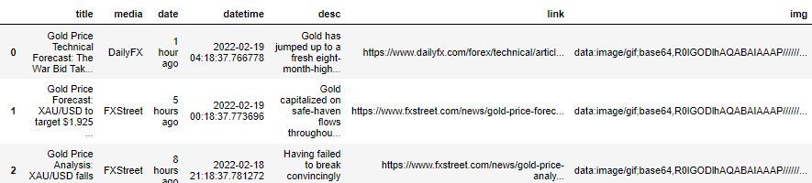
Data Collection from Google News
We uses Python Library “GoogleNews”
Search = XAUUSD
We managed to obtain 20 news that was spread cross 2 days.

Slide 8
Pre-Processing for Tweets and News
We use NLTK to clean the data, by removing the special characters, stopwords, and lemmatization.
We drop unnecessary columns, including the timestamps.

Slide 9
Sentiment Analysis
We uses “Bag of Words” to determine the Sentiment of the Tweets and News.
Then we created a ‘polarity’ column, where ‘1’ is positive and ‘-1’ is negative sentiment.

Slide 10
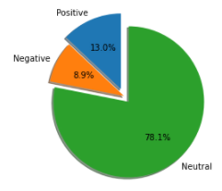
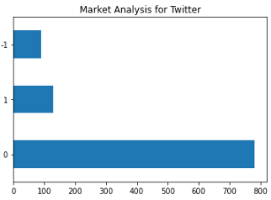
Visualisation From Twitter
From the 1000 Tweets, there are 120 positive, and 89 negative sentiments.
There are a lot of neutral tweets, which are wasted. Only 10%+ of tweets proves to be quality.

Slide 11
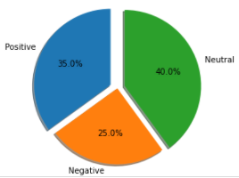
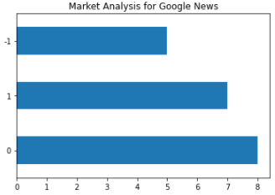
Visualisation from Google News
From the 20 news, we can see 7 are positive, 5 are negative sentiments.
There are much less ‘neutral’ entries; shows that the quality of the result are higher.

Slide 12
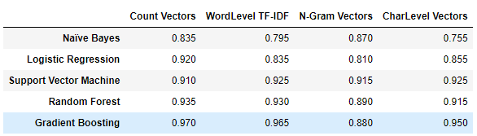
Machine Learning Modeling
Based on the Twitter Dataset, we ran Machine Modeling on it.

Slide 13
Conclusion
Here we build a basic framework of Sentimental Analysis.
There are still a lot of improvements that can be done.

